Slide 1

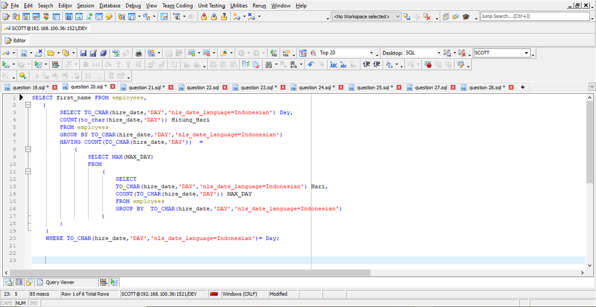

SQL Practice

Slide 2
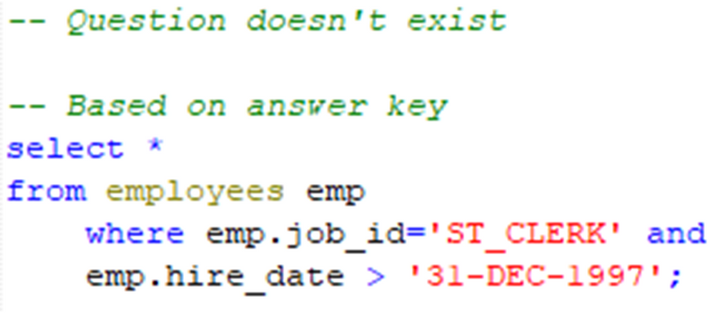
Question 1

Slide 3
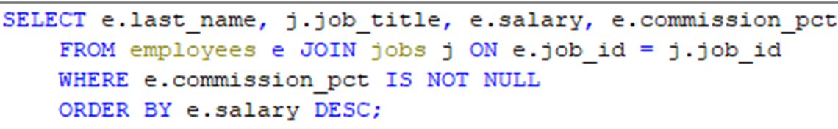
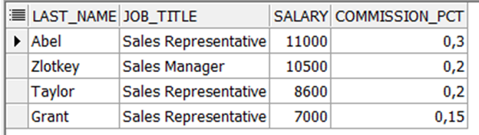
Question 2
Show the last name, job, salary, and commission of those employees who earn commission. Sort the data by the salary in descending order.

Slide 4
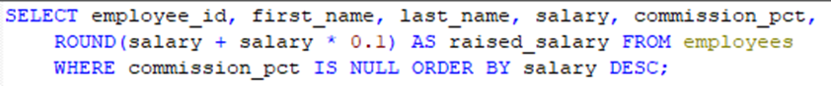
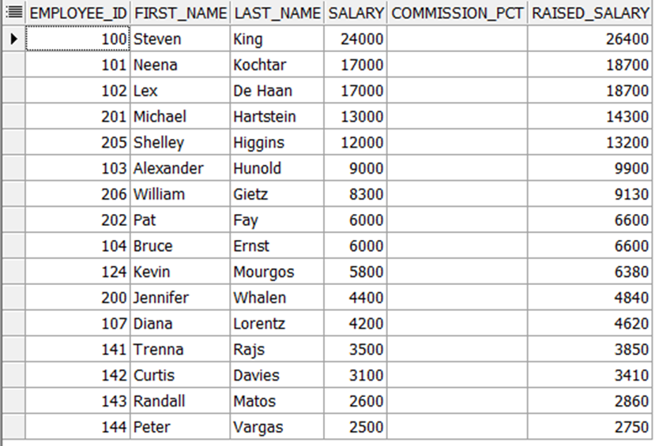
Question 3
Show the employees that have no commission with a 10% raise in their salary (round off the salaries).

Slide 5
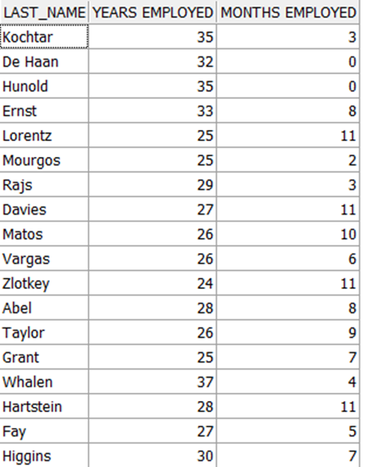
Question 4
Show the last names of all employees together with the number of years and the number of completed months that they have been employed.

Slide 6
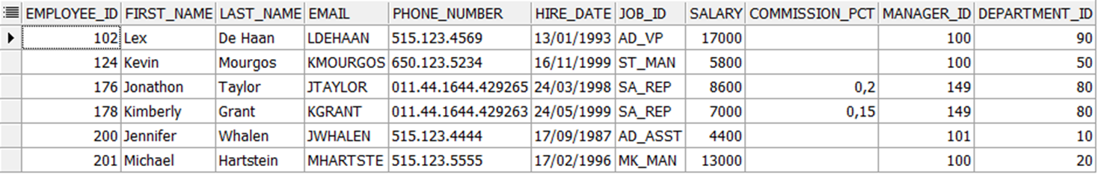
Question 5
Show those employees that have a name starting with J, K, L, or M.

Slide 7
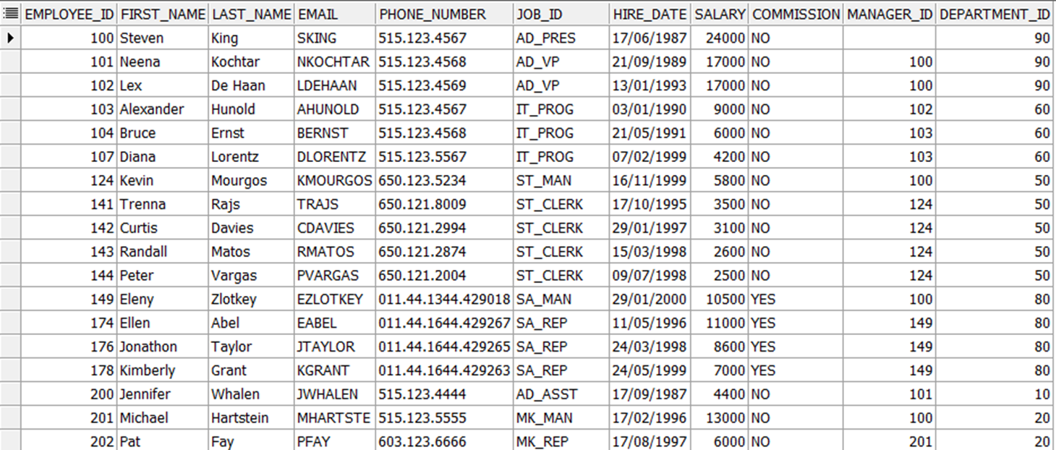
Question 6
Show all employees, and indicate with “Yes” or “No” whether they receive a commission.

Slide 8
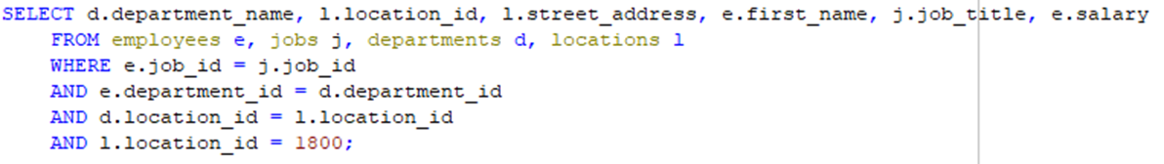
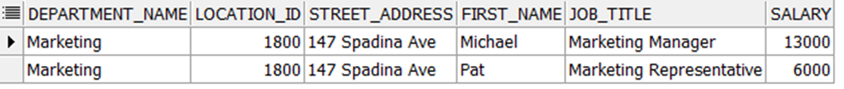
Question 7
Show the department names, locations, names, job titles, and salaries of employees who work in location 1800.

Slide 9
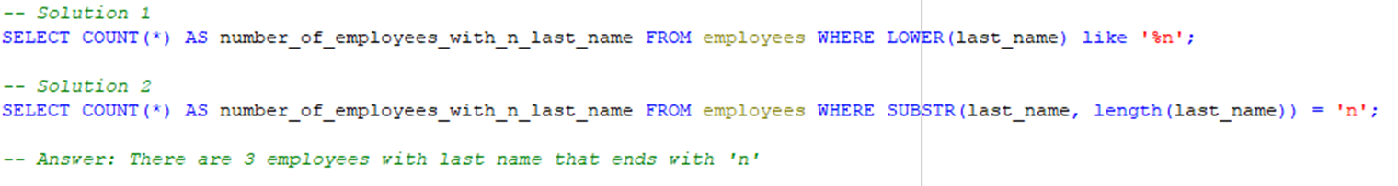
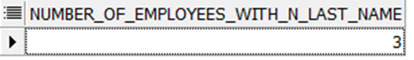
Question 8
How many employees have a last name that ends with an n? Create two possible solutions.

Slide 10
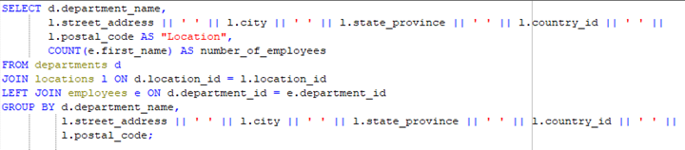
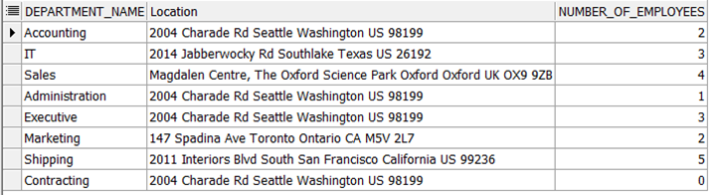
Question 9
Show the names and locations for all departments, and the number of employees working in each department. Make sure that departments without employees are included as well.

Slide 11
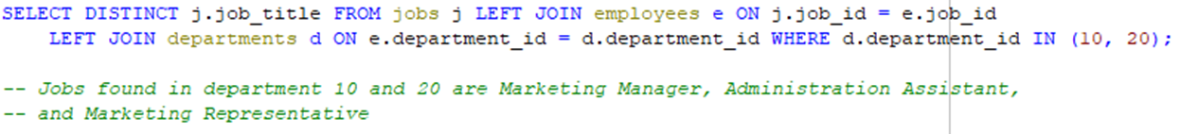
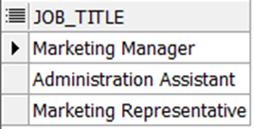
Question 10
Which jobs are found in departments 10 and 20?

Slide 12
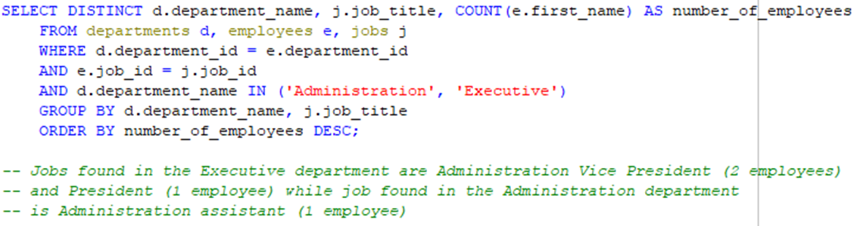
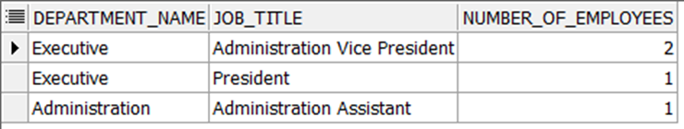
Question 11
Which jobs are found in the Administration and Executive departments, and how many employees do these jobs? Show the job with the highest frequency first.

Slide 13
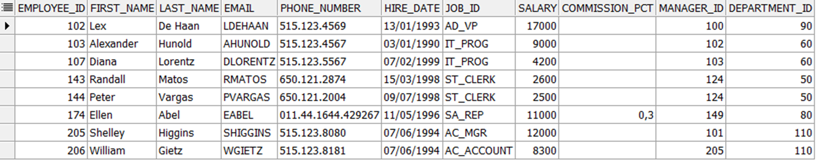
Question 12
Show all employees who were hired in the first half of the month (before the 16th of the month).

Slide 14
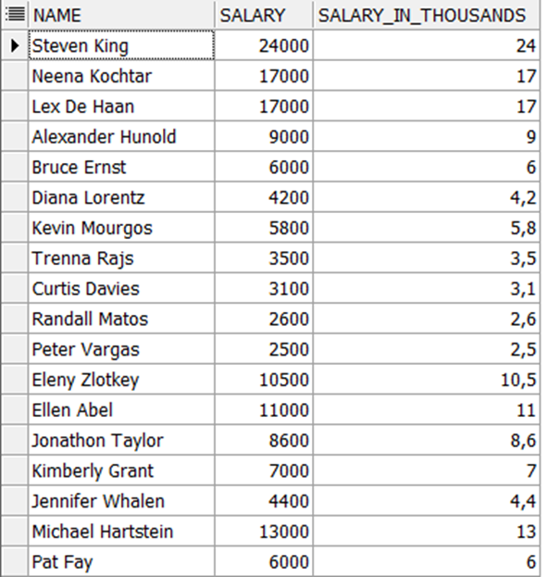
Question 13
Show the names, salaries, and the number of dollars (in thousands) that all employees earn.

Slide 15
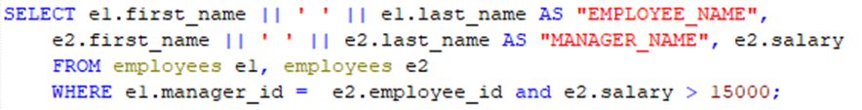
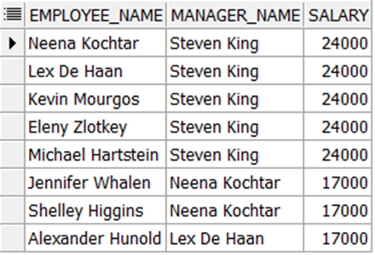
Question 14
Show all employees who have managers with a salary higher than $ 15,000. Show the following data: employee name, manager name, manager salary, and salary grade of the manager.

Slide 16
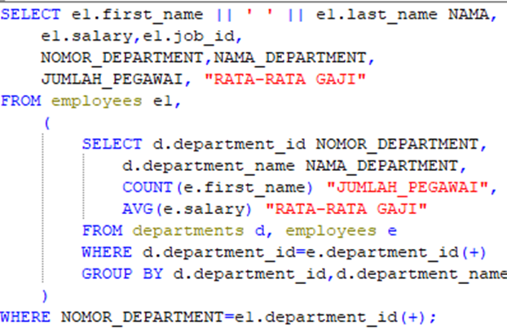
Question 15
Show the department number, name, number of employees, and average salary of all departments, together with the names, salaries, and jobs of the employees working in each department.

Slide 17
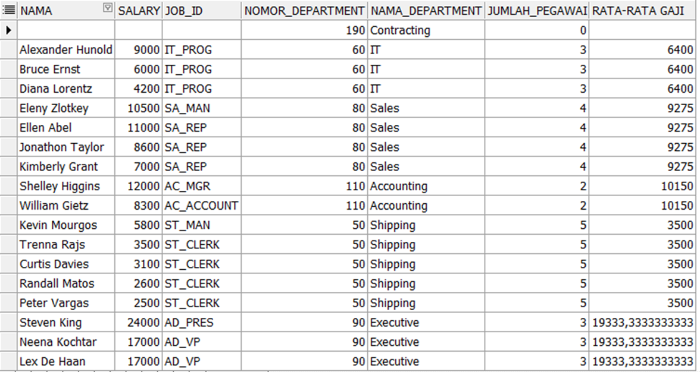
Question 15

Slide 18
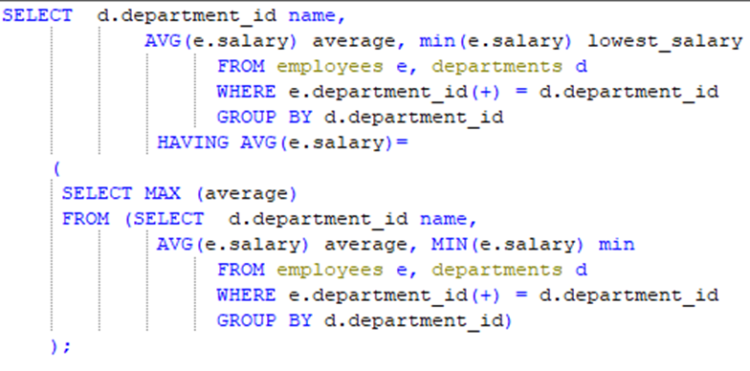
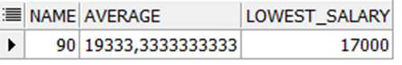
Question 16
Show the department number and the lowest salary of the department with the highest average salary.

Slide 19
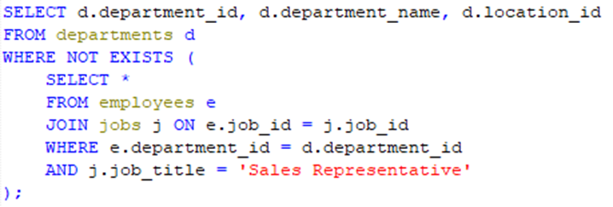
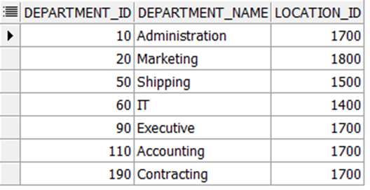
Question 17
Show the department numbers, names, and locations of the departments where no sales representatives work.

Slide 20
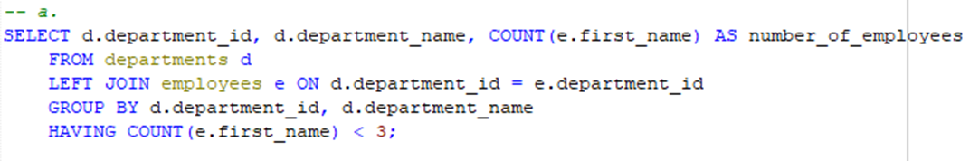
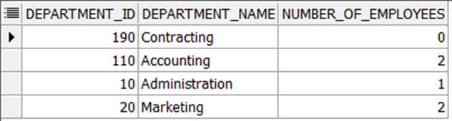
Question 18
Show the department number, department name, and the number of employees working in each department that:
a. Includes fewer than 3 employees

Slide 21
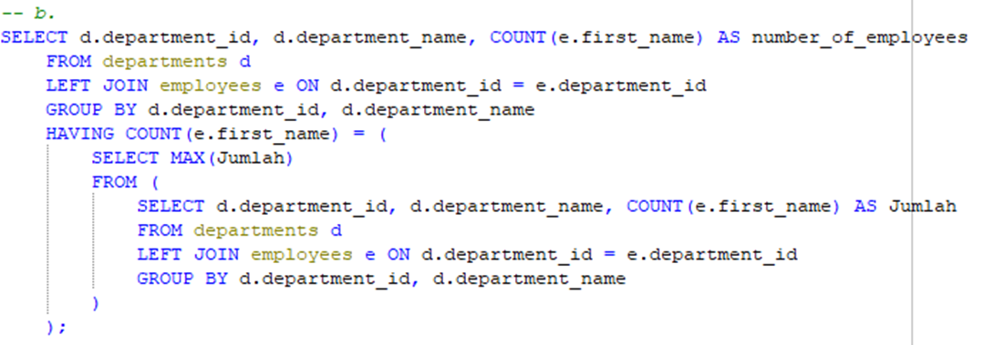
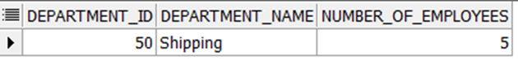
Question 18
Show the department number, department name, and the number of employees working in each department that:
b. Has the highest number of employees

Slide 22
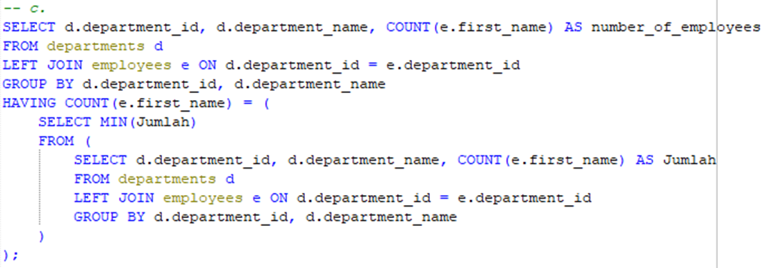
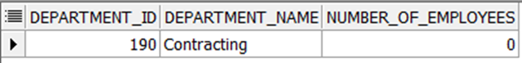
Question 18
Show the department number, department name, and the number of employees working in each department that:
c. Has the lowest number of employees

Slide 23
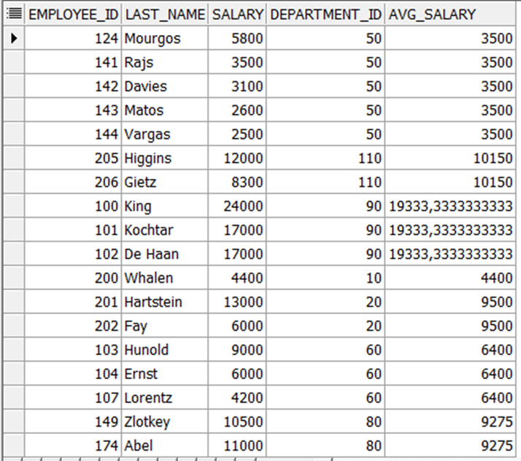
Question 19
Show the employee number, last name, salary, department number, and the average salary in their department for all employees

Slide 24
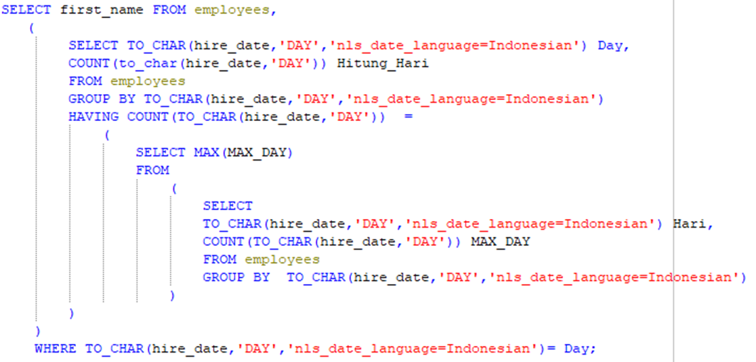
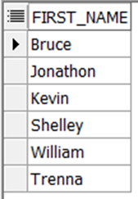
Question 20
Show all employees who were hired on the day of the week on which the highest number of employees were hired

Slide 25
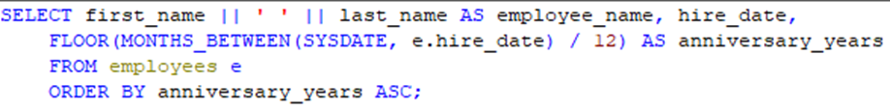
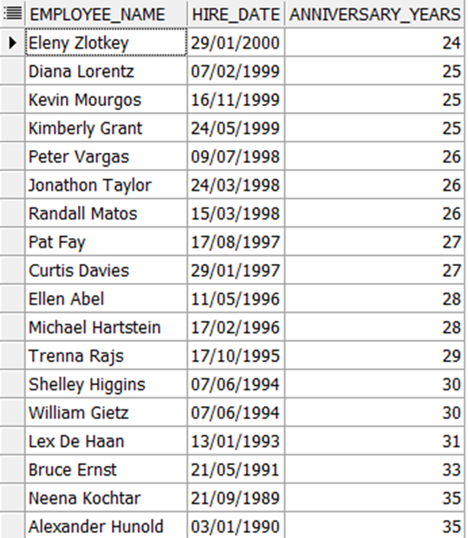
Question 21
Create an anniversary overview based on the hire date of the employees. Sort the anniversaries in ascending order

Slide 26
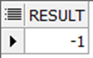
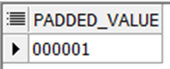
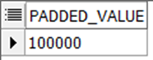
Question 22
Fungsi untuk mengetahui minus atau tidaknya suatu angka
Inputan : -20
Output : -1
Fungsi untuk memaksakan panjang dari suatu karakter, walaupun inputan kurang dari karakter tersebut.
Inputan : 1
Output : 000001 atau 100000

Slide 27
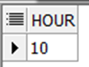
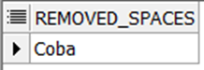
Question 23
Fungsi untuk mengambil format jam dari inputan date
Inputan : ’20-AUG-2006 10:30:31’
Output : 10
Fungsi untuk menghapus spasi dari suatu statement yang mengandung spasi
Inputan : ‘Coba ‘
Output : ‘Coba’

Slide 28
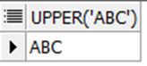
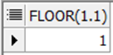
Question 24
Fungsi untuk membesarkan semua huruf dalam suatu statement
Inputan : ‘abc’
Output : ‘ABC’
Fungsi untuk membulatkan ke bawah inputan desimal
Inputan : 1.1
Output : 1

Slide 29
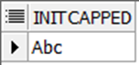
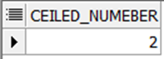
Question 25
Fungsi untuk membuat statement berformat berikut :
Inputan : ABC
Output : Abc
Fungsi untuk pembulatan ke atas untuk inputan number :
Inputan : 1.1
Output : 2

Slide 30
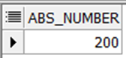

Question 27
Fungsi untuk memaksakan apapun inputan dari number selalu jadi positif
Input : -200
Output : 200
Fungsi untuk membuat statement berformat berikut :
Inputan : ABC
Output : abc

Slide 31

Question 28
Fungsi untuk mengetahui jumlah bulan antara dua buah tanggal
Input : 20-JAN-2006 dan 20-AUG-2006
Output : 7

Slide 32

TERIMA KASIH

